Slide 1
Rigor and Reproducibility
Michael Kalichman and Paul Mills
UC San Diego
Supported by Altman Clinical Translational Research Institute
And the UC San Diego Research Ethics Program

Slide 2
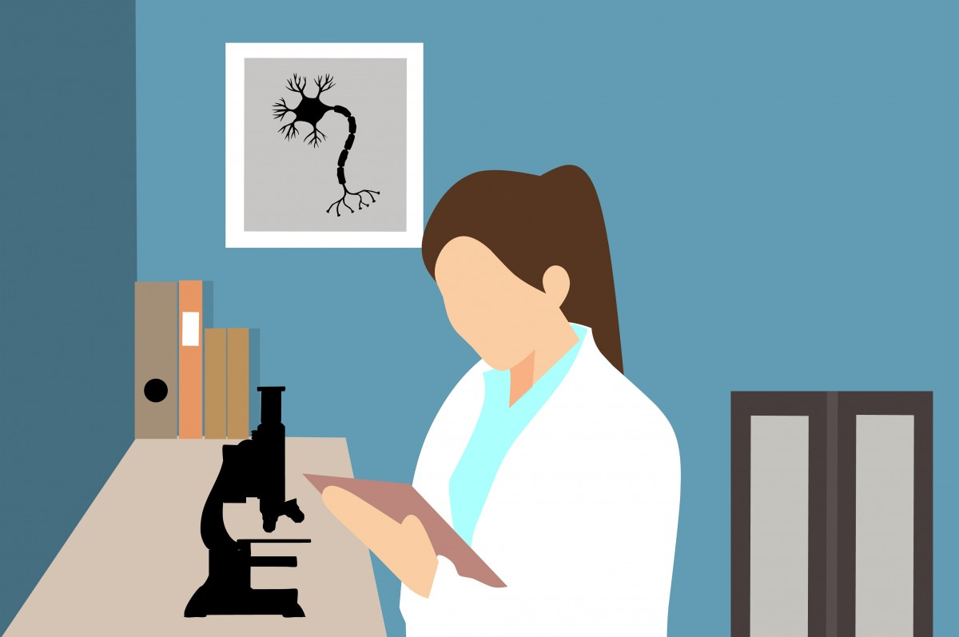
Science
Notes:
Scientists and engineers tend to choose these career paths in the hope of contributing to our ability explain and understand the world we live in.
Picture source: https://pxhere.com/en/photo/1457639

Slide 3

Notes:
The results of our research are published, making it possible for others to build on what we have done.
Picture source: https://pxhere.com/en/photo/765774

Slide 4
p<0.05
Notes:
For much of experimental science, the standard to be able to get published is a less than 5% chance probability that your findings would be wrong.

Slide 5
Ioannidis JPA (2005):
Why most published research findings are false.
PLoS Med 2(8): e124.
Notes:
In 2005, Ioannidis published an essay in which he had used theory and simulations to demonstrate the risk that not just 5% , but perhaps more than half of research findings might turn out to be false.

Slide 6


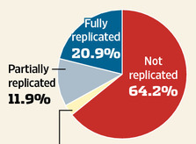
Bayer tried to replicate results of 67 studies in academic journals
Amgen undertook a project to reproduce the results of more 53 “landmark” published studies
Only 11% were reproducible - even by the original researchers who had done the work
Figure from: https://www.drugabuse.gov/about-nida/noras-blog/2013/09/improving-reproducibility-transparency-in-biomedical-research
Prinz F et al. (2011): Believe it or not: how much can we rely on published data on potential drug targets? Nat Rev Drug Discov 10(9):712.
Begley CG and Ellis LM (2012): Drug development: Raise standards for preclinical cancer research. Nature 483:531–533
Notes:
Several years of Ioannidis’ theoretical analysis, Bayer and Amgen independently tried to replicate 67 and 53 published studies. The result was clear reproducibility in only 21% and 11% of their attempts.

Slide 7
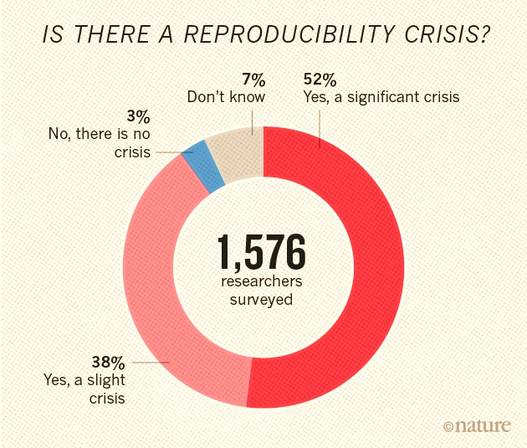
Baker M (2016):
Is there a reproducibility crisis?
Nature 533:452-454.
Notes:
Based on the Bayer and Amgen studies, and many other studies as well as personal experience, 90% of the scientific community agreed that we are facing a reproducibility crisis. That doesn’t mean the issues are new, but it does mean elevated attention.

Slide 8
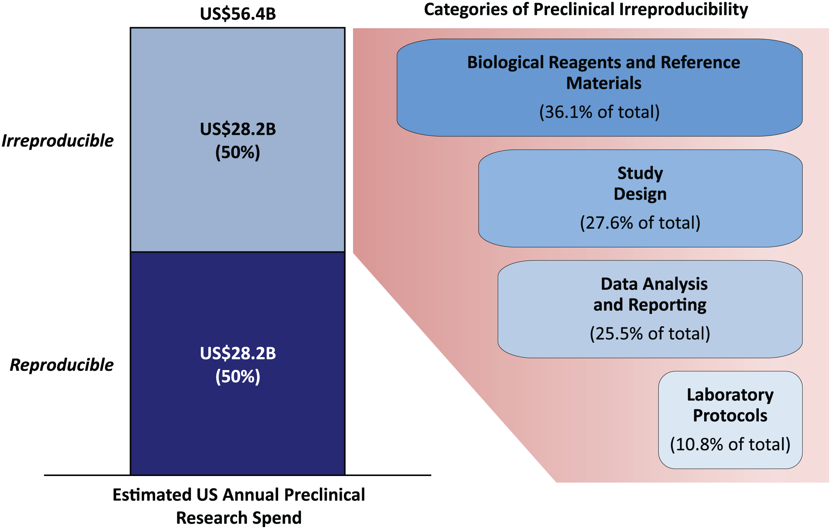
Factors contributing to crisis
Freedman et al. (2015): The Economics of Reproducibility in Preclinical Research. PLOS Biology
Notes:
Many factors might contribute to irreproducible research, but one study has proposed at least these four areas of risk in preclinical research: Reagents and Materials, Design, Data analysis and Reporting, and Protocols.

Slide 9
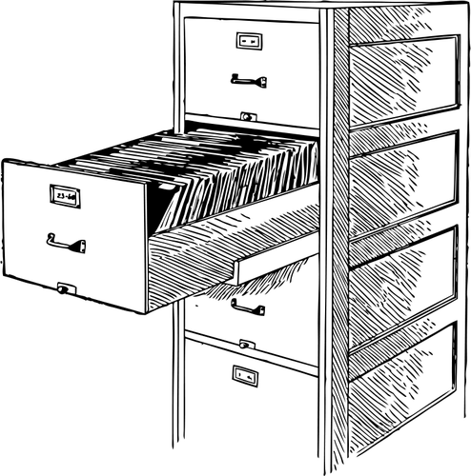
File drawer
phenomenon
Notes:
One example of the challenges to the integrity of the research literature is the “file drawer phenomenon.” This references the many research studies that are conducted and fail to research statistical significance. Because the findings are negative (i.e., no effect), it is difficult or impossible to publish. At the same time, if enough people are studying the same phenomenon, it is expected that 5% of those studies would achieve “statistical significance,” and be publishable – even though there is no real effect. All of the other studies showing no effect would remain in the file drawer, leaving an incorrect impression of a positive outcome.
Picture from: https://freesvg.org/vector-image-of-open-file-drawer

Slide 10

Causes of failure to reproduce published work
Fraud
Unknown factors
Failures of design,
documentation, or reporting:
  Intentional
  Unintentional
Useful
Easy and inexpensive
Not typically done
Notes:
Taken together there are many reasons published research might not be reproducible. Fraud is of concern and can be addressed in a variety of ways, but is hopefully infrequent. It is also possible that a study may result in a positive outcome dependent on factors that are not known, making it impossible for others to reproduce the work. Because the factors are unknown, there is little that can be done a priori, but this is worth considering as one possible reason something can’t be reproduced. It is likely that most cases of reproducibility result from some failure in design, documentation, or reporting. In those cases where these failures are unintentional, there is clearly an opportunity to to do better. The purpose of this workshop is to think about possible solutions. Interestingly you will likely see that many of these solutions would be useful, are easily carried out, and unfortunately not typically done.
Picture from: https://freesvg.org/solutions-button-vector-illustration

